Slide 1
NOISE POLLUTION MONITORING

Slide 2

PROBLEM STATEMENT
Noise pollution is a growing concern in urban and residential areas, adversely affecting public health and quality of life. The problem statement is to design and implement an effective noise pollution monitoring system to address this issue.

Slide 3
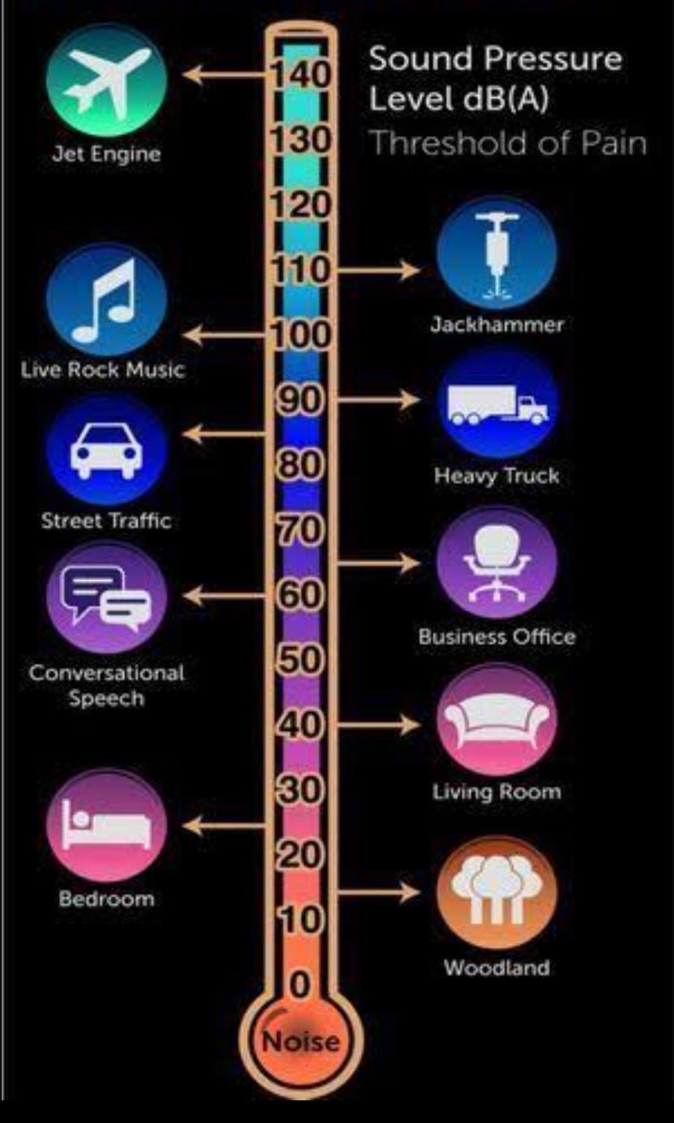
METHODOLOGY
Monitoring noise pollution using the Internet of Things (IoT) involves the integration of sensors, data transmission, and data analysis.
Sensor Selection:
Choose appropriate noise sensors (e.g., sound level meters or microphones) capable of measuring sound levels accurately. Consider factors like frequency range, sensitivity, and environmental durability when selecting sensors. Sensor Placement: Identify strategic locations for sensor placement, considering areas of interest and potential noise sources (e.g., roads, factories, residential areas). Ensure sensors are adequately spaced for comprehensive coverage.

Slide 4
Data Transmission: Use a reliable communication protocol (e.g., Wi-Fi, cellular, LoRa, or NB-IoT) to transmit data from IoT devices to a central data repository. Ensure secure and encrypted data transmission to protect sensitive information.
Real-time Monitoring: Set up a dashboard or web application for real-time noise level monitoring. Display noise data in a user-friendly interface, allowing users to visualize current noise levels.

Slide 5
HARDWARE COMPONENTS
Noise Sensors: High-precision noise sensors strategically placed across the target area for data collection. Data Logger: A central data logging unit to collect, timestamp, and store noise level data from sensors. Communication Infrastructure: Reliable internet connectivity or a dedicated network for real-time data transmission. Power Supply: A stable power source or backup system to ensure continuous monitoring.

Slide 6
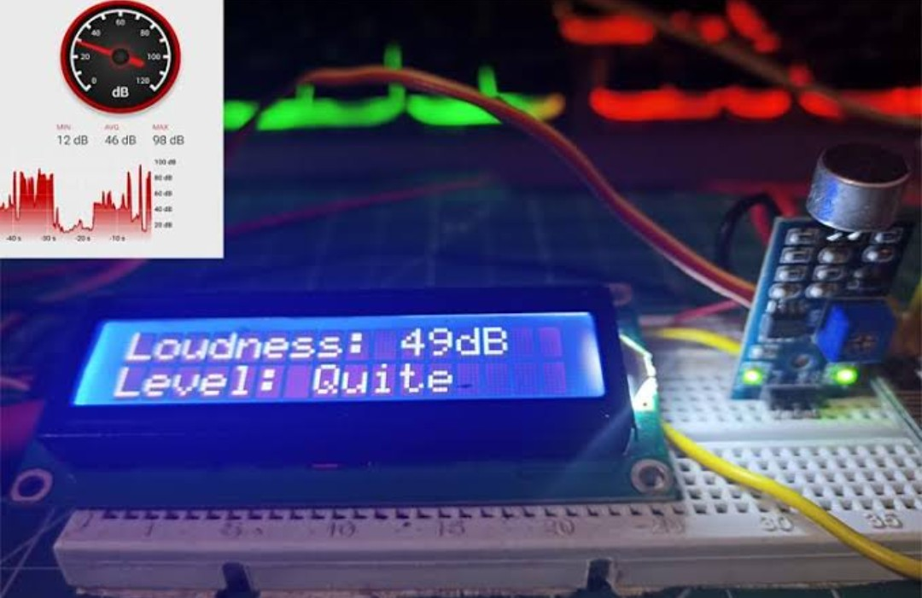
PROBLEM SOLUTION
Develop a comprehensive noise pollution monitoring system that meets the following criteria: Real-time Monitoring: Collect and transmit noise data in real-time for immediate analysis. Data Storage: Store historical noise data for trend analysis and reporting. Data Analysis: Implement algorithms to identify noise sources, patterns, and anomalies. User Interface: Create a user-friendly interface for data visualization and reporting. Alert System: Implement an alert system to notify relevant authorities or the public of excessive noise levels. Integration: Enable integration with geographic information systems (GIS) for spatial analysis.

Slide 7
CONCLUSION
A well-designed noise pollution monitoring system will provide valuable insights into noise patterns, helping communities and authorities make informed decisions regarding noise mitigation strategies. By identifying noise sources and their impact, this system contributes to creating quieter and healthier urban and residential environments, ultimately improving the overall quality of life for residents. Implementing such a system will require careful consideration of hardware components, data management, and analysis techniques to achieve the desired results and address the problem of noise pollution effectively.

Slide 8
THANK YOU

